Slide 1
Example of Cooperative Game
There are 3 players, each having a job to do
The cost of each working individually
V({1}) = V({2}) = V({3}) = 10
The cost of any two working collaboratively
V({1,2}) = V({1,3}) = V({2,3}) = 14
The cost of all three working collaboratively
V({1,2,3}) = 18
Question: are the three willing to work collaboratively?
We need a way of sharing the cost V({1,2,3}) = 18 among the players
An easy solution (6, 6, 6)
How about the following ways of sharing cost?
{7,7,4}, {8,6,4}, {4,4,10},…

Slide 2
The Formulation
We need a way of sharing the cost V({1,2,3}) = 18 among the players,{x₁, x₂, x₃}, satisfying
x₁ ≤ 10,
x₂ ≤ 10,
x₃ ≤ 10,
x₁ + x₂ ≤ 14,
x₁ + x₃ ≤ 14,
x₂ + x₃ ≤ 14,
x₁+x₂+x₃ = 18.
All are feasible solutions
{6,6,6}, {7,7,4}, {8,6,4},{4,4,10},…
They are said to be in the core of the game

Slide 3
The Core may be empty
Suppose that
V({1}) = V({2}) = V({3}) = 10
V({1,2}) = V({1,3}) = V({2,3}) = 14
V({1,2,3}) = 22
There is no feasible solution to the following constraints
x₁ ≤ 10, x₂ ≤ 10, x₃ ≤ 10,
x₁ + x₂ ≤ 14, x₁ + x₃ ≤ 14, x₂ + x₃ ≤ 14
x₁+x₂+x₃ = 22
Core is empty
Centralized optimal decision cannot be reached

Slide 4
Scheduling with machine activation cost
activation cost K= 9.5
p₁=2
p₂=3
p₃=4
p₄=5
Coalition of p₁ and p₂
No cooperation
p₁=2
p₂=3
C=11.5
p₁=2
C = 9.5 + 2 + 5 = 16.5
To be shared by the two
C=12.5
p₂=3
C=13.5
p₃=4
Coalition of p₁, p₂, p₃
C=14.5
p₄=5
p₁=2
p₂=3
p₃=4
C = 9.5 + 2 + 5 + 9= 25.5
To be shared by the three

Slide 5
The grand coalition
p₁=2
p₂=3
p₃=4
p₄=5
C = 9.5 + 2 + 5 + 9 + 14 = 39.5 (Optimal?)
p₁=2
p₃=4
p₂=3
p₄=5
C = 9.5 + 2 + 6 + 9.5 +3 + 8 = 38
To be shared by the four (How?)

Slide 6
Related Concepts
Approximate core
???
Least core
???
…
Focusing on bounds
How to help making decisions?

Slide 7
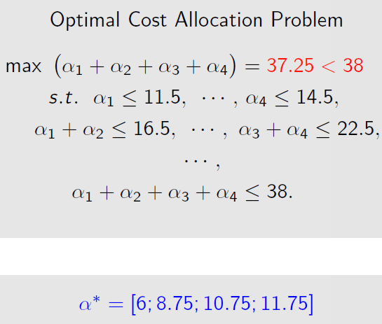
Subsidization
Subsidy
An outside party chips in ω=0.75, making up the deficit.

Slide 8
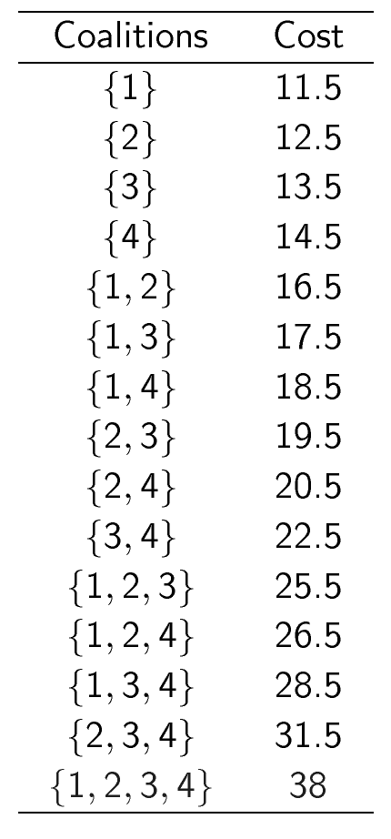
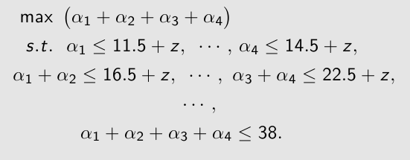

Penalization
The outside party as the rule maker：
For any coalition that does not join the grand coalition, please pay a penalty of z
Zmin = 0.5
Result: No one pays the penalty

Slide 9
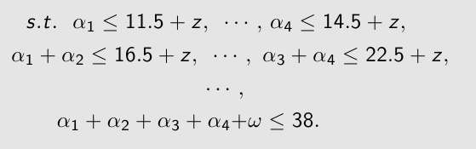

Simultaneous subsidization and penalization
Outside party as the rule maker:
(1) For any coalition that does not join the grand coalition, please pay a penalty of z
(2) Outside party subsidizes grand coalition ω
For example, ω=1/2, z=1/6

